Slide 1
“Identification and handling of electronic evidence” and “Digital forensics”

Slide 2
Agenda
Background
Recommendations on internet payments (ECB)
Solving one customers problems
Investigating traces
Evaluating gathered data
Individual challenge
Discussion and wrap-up

Slide 3
Disclaimer
References made herein to any specific commercial product, process, or service by trade name, trademark, manufacturer, or otherwise, does not necessarily constitute or imply its endorsement, recommendation, or favoring by ENISA.
The references to material used are in the notes section.

Slide 4
Economy
Russian mafia made more money in online banking than the drug cartels made selling cocaine
Russian cybercriminals earned $4.5 billion in 2011
Notes:
http://www.computerworld.com/s/article/9226498/Russian_cybercriminals_earned_4.5_billion_in_2011
http://www.group-ib.com/images/media/Group-IB_Report_2011_ENG.pdf

Slide 5
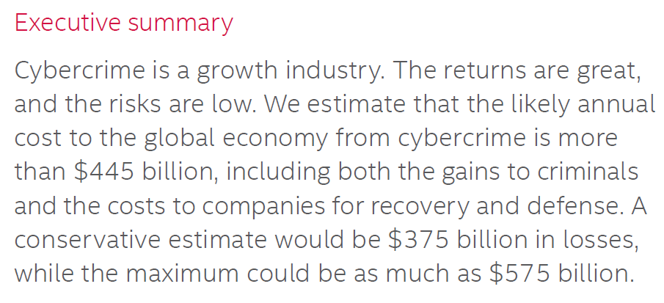
Estimating the Global Cost of Cybercrime
Notes:
http://csis.org/files/attachments/140609_McAfee_PDF.pdf
http://csis.org/files/attachments/140609_rp_economic_impact_cybercrime_report.pdf

Slide 6
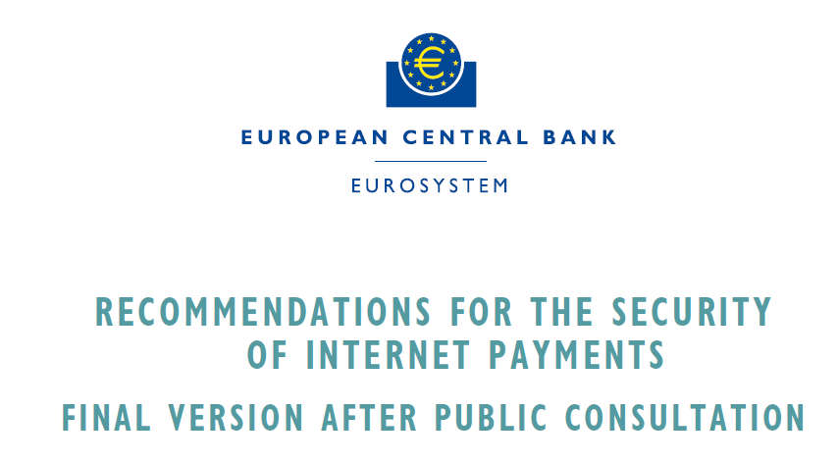
Notes:
http://www.ecb.europa.eu/pub/pdf/other/recommendationssecurityinternetpaymentsoutcomeofpcfinalversionafterpc201301en.pdf?ea09bd2b9f5008bf6308c8ebd5a74156

Slide 7
“comply or explain” principle
Should be implemented by 1 February 2015 (shorter deadline might be implemented by national authorities)

Slide 8
General control and security environment
Consider technology risks on both sides
Incident monitoring, handling and reporting (immediately in some cases)
Network segregation and least privilege principle
Hardening and having sec. solutions
Privacy by design and data minimisation
Security testing and auditing
E-merchants must comply and implement security solutions (contractually)

Slide 9
Specific controls and security measures for Internet payments
User must get info about the requirements on his side (antivirus, firewall, etc. and guidelines on how to use credentials)
Delivery of authentication tools is secure
Minimum session time
Transaction monitoring and usage of fraud detection and prevention systems
User behavioural analysis (IP, geolocation, script vs. human detection)

Slide 10
Customer awareness, education and communication
Provide secure channel
Educate user to minimum standards
E-merchants should clearly separate payment from the e-shop (education to e-merchants)
Personalised rules for customers
Real time opportunity to balance and transaction status

Slide 11
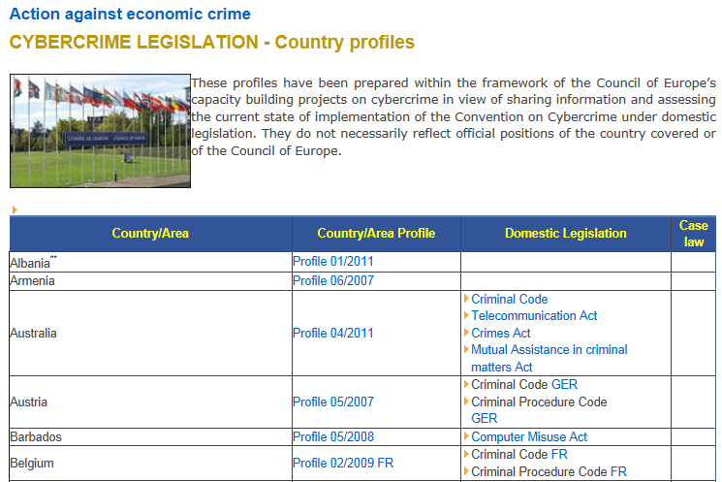
Notes:
http://www.coe.int/t/dghl/cooperation/economiccrime/cybercrime/documents/countryprofiles/default_en.asp

Slide 12
Banking systems
We can divide data generally available at a banking systems into two main categories
Directly linked to transactions made
Additional data, related to the technology used behind the scenes

Slide 13
Directly linked
Transaction
Source account
Destination account
Currency
Payee
Title and description
Transfer type
Amount of money
Recipient
Notes:
Source and destination account numbers – one of them is typically a local account in the banking system analysed, the other can be local or an account in different bank.
Amount of money in the transaction
The transaction currency
Payee
Transfer type (standard, fast, SWIFT and others)
Title or description put on the order

Slide 14
Sample buildup
Transaction: MoneyTransfer
Parameters: sourceAccNo, destAccNo, sourceBalance, destBalance, transferSum
Initial state: sourceBalance = X, destBalance = Y
Final state: sourceBalance = X – transferSum, destBalance = Y + transferSum
Operations: Approve, Locate, Authorize, Debit, Credit
Intermediate states: Sum requested, Transfer approved/rejected, Source located, Transfer initiated/aborted, Source debited, Destination credited
Notes:
http://www.google.gr/url?sa=t&rct=j&q=&esrc=s&frm=1&source=web&cd=4&cad=rja&ved=0CD8QFjAD&url=http%3A%2F%2Fcomputing.unn.ac.uk%2Fstaff%2Fcgma2%2Fcm036%2FOldStuff%2FWeek4%2FTransactionsAndRecovery_Sem.doc&ei=zBXhUu7gN4SJyQOIxIHoBA&usg=AFQjCNEBhos0b-2mnRfArYE0S3XlNTrz1g&sig2=EGi37sn3dSVFNlBr0YgVKQ

Slide 15
Additional data
Additional data
Status of the login attempt (success, failure)
HTTP session data
Headers: User-Agent, Accepted-Languages, Accept-Encoding
IP address of the far end (user)
Cookies
Notes:
Additional data include information specific to the electronic banking system such as:
1. Data regarding user login:
a. IP address of the far end (user)
b. Status of the login attempt (success, failure)
2. HTTP session data:
a. Headers: User-Agent, Accepted-Languages, Accept-Encoding
b. Cookies

Slide 16
Electronic banking services are normally configured to collect and store information about users logging in and out.
They also log any transactions made and/or authorized by a user to assure non-repudiation.

Slide 17
Our bank
Located in Europe
Operates worldwide
Offers e-banking solution

Slide 18
Physical protection in the bank is state of the art

Slide 19
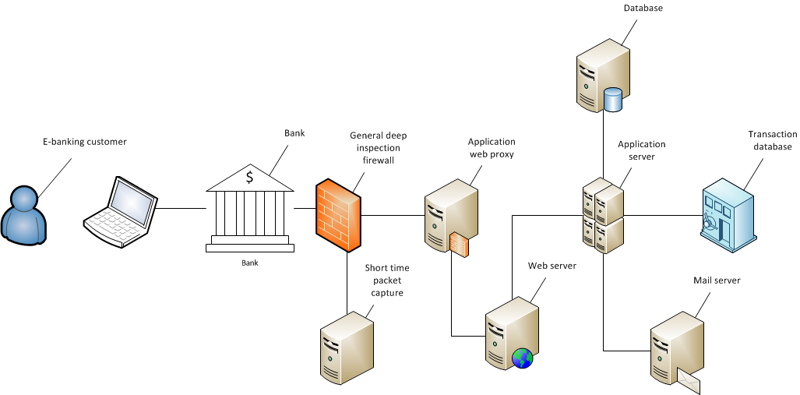
Basic build-up of our bank e-banking solution

Slide 20


Hello this is Peter, Kowalski I logged in from work now, and saw a transaction in internet bank statement that I haven't done.
Hello, this is PL BANK, could you please specify?

Slide 21
Thank you for notification, we will look into this matter and get back to you soon!
I am just looking at that transaction in e-bank.

Slide 22

Hi, we just had a complaint from Peter with ID client94777, that he has noticed an unknown transaction, I checked the transaction details and they are legitimate. could you please check if you find something unusual?
Ok I will see what I can do.

Slide 23
As well the user told he was logged in to the bank around the time he called 21st August at 17:30
Ok good to know.

Slide 24
syslog.log file containing the log of initiated user sessions, containing cookie information, extracted from pcap file
client.csv file containing information about users and their online sessions identified by cookie information
pcap file (tcpdump.pcap) to identify characteristics which are not present in the access_log files
access_log from HTTP server, Apache

Slide 25
Lets start with with sharks
Wireshark
T-Shark
Great hammerhead

Slide 26
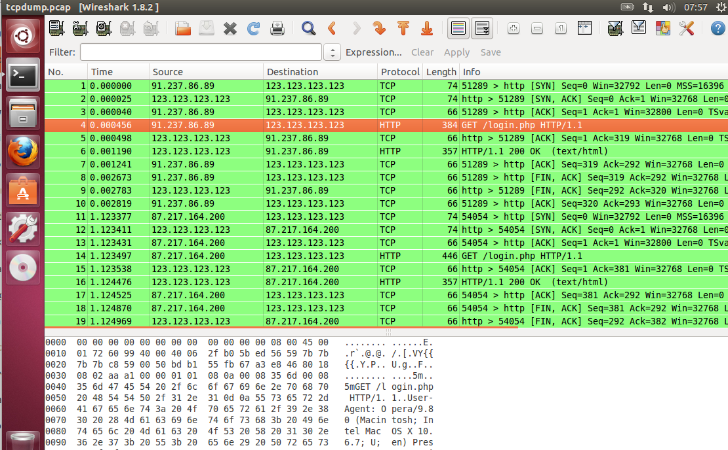
Wireshark

Slide 27
tshark
$tshark -r network.pcap -T fields -e ip.src -e dns.qry.name
Details:
Read pcap_file: -r ‘pcap_file’
Set format of the output: -T pdml|psml|ps|text|fields
Add a list of fields to the out of ‘-T fields’: -e Ip.src

Slide 28
T-Shark
tshark -nn -r tcpdump.pcap -T fields -E separator='|' -R 'http.request' -e ip.src -e frame.time -e http.request.uri -e http.user_agent -e http.cookie > tshark.log

Slide 29
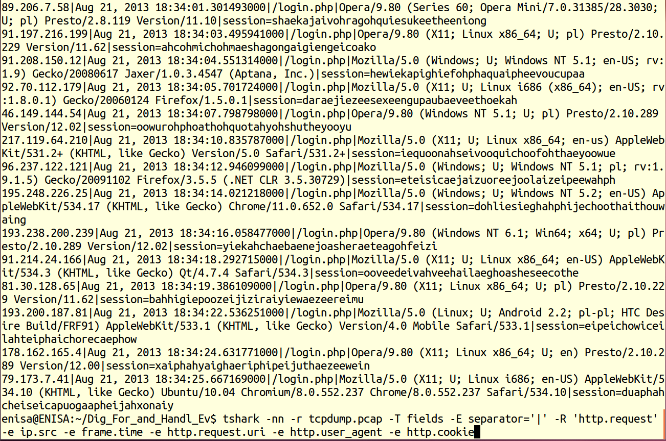
T-Shark

Slide 30
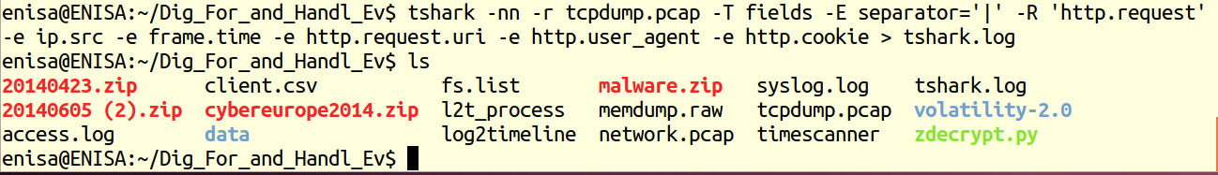
T-Shark

Slide 31
Identify the sessions related to the client
client.csv might be the source to identify sessions
client94777

Slide 32
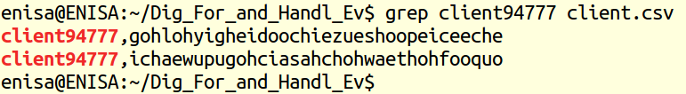
grep client94777 client.csv
Notes:
There are two sessions found for this user, but we know only the cookies of these sessions. We have to look through system log to see when the two sessions started. We could look into the tshark.log instead of syslog as both files are extracted from a pcap; this one is more readable however:

Slide 33
When the two sessions started ?
syslog.log
tshark.log
grep

Slide 34
grep gohlohyigheidoochiezueshoopeiceeche syslog.log
grep ichaewupugohciasahchohwaethohfooquo syslog.log
Notes:
customer questioning has ID client94777 and the compliant was made by him on 21st August at 17:30 of local time. We know that the user had a legitimate session open during the bank call centre and the customer claimed to have been online with the banking application for around 15 minutes at that time.
There are two sessions found for this user, but we know only the cookies of these sessions. We have to look through system log to see when the two sessions started. We could look into the tshark.log instead of syslog as both files are extracted from a pcap; this one is more readable however:

Slide 35
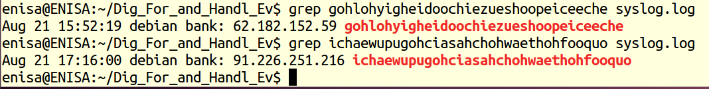
When the two sessions started ?

Slide 36
grep 91.226.251.216 access.log

Slide 37
Getting more info

Slide 38
grep 62.182.152.59 access.log
Notes:
http://www.jafsoft.com/searchengines/log_sample.html

Slide 39
Getting more info

Slide 40
geoiplookup 91.226.251.216
geoiplookup 62.182.152.59
Notes:
The browser asked for Russian language, but apparently the connection came from Ukraine. Is there any other clue? Well, the User-Agent field is actually malformed, there is another pair of apostrophes (‘ ’) inside double apostrophes (“ “). It does not happen normally. Usually it means the string was manipulated, possibly from a script. However, it doesn’t mean this is bad by itself.
Now, after the case is solved, present the trainees with an alternative http server config and the access log generated by this configuration. In that case pcap files wouldn’t have been needed, all the information is logged directly by http server. We consider it a good practice to configure a web server in this way for increasing incident handling capabilities.
An example of custom log configuration for Apache webserver is presented below:
CustomLog ${APACHE_LOG_DIR}/access.log "%h %l %u %t \"%r\" %>s %b
\"%{Referer}i\" \"%{User-agent}i\" \"%{Accept-Language}i\" \"%{Cookie}i\""

Slide 41
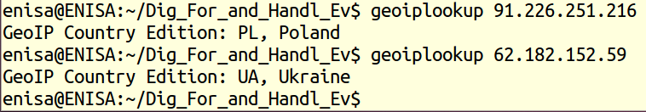

Slide 42
Identified factors:
Identifying that fraudulent session was connected from Ukraine
The web browser identified itself as Mozilla while the user before connected from Opera
Preferred language was set to Russian
The user agent string was malformed

Slide 43
Identify other attacked customers
grep Mozilla access.log | wc –l
grep ‘ ru;’ access.log | wc –l
grep \”\’ access.log | wc –l

Slide 44
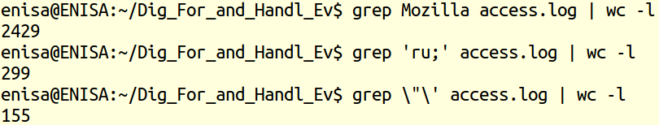
Identify other attacked customers

Slide 45
Identify other attacked customers
for i in `cat access.log | cut –f1 –d ‘ ‘ `; do geoiplookup $i; done | grep Ukraine | wc –l
for i in `cat access.log | cut –f 1 –d ‘ ‘ `; do geoiplookup $i; done | sort | uniq | wc –l
cat access.log | wc –l
Notes:
This demonstration was an example of the importance of matching many small factors together. As we can see there were 2429 connections from Mozilla browser (wc –l counts the lines of input), 299 times the preferred language was Russian, even the malformed header occurred 155 times. There were 232 connections from Ukraine and a total of 3252 connections were initiated from 73 countries, the most exotic ones being A2 Satellite Provider or Trinidad and Tobago.

Slide 46
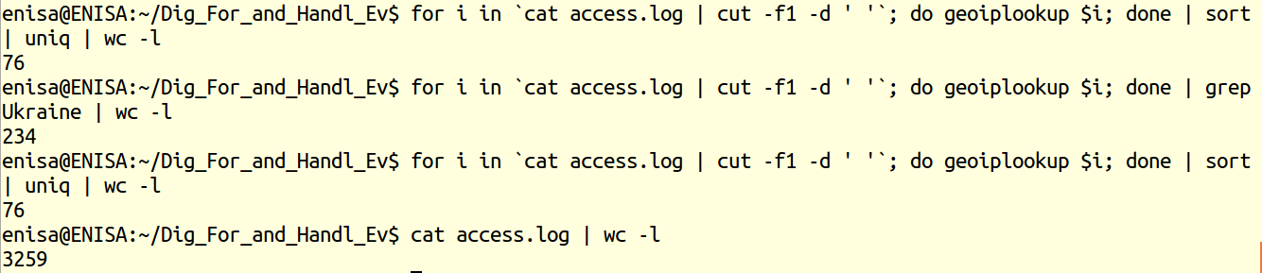
Identify other attacked customers

Slide 47
Identify other attacked customers
grep Mozilla access.log | grep ‘ ru;’ | grep \”\’
Notes:
In the mass of all events registered at a large bank a single property for a connection is not very useful, except for statistics. We have to apply all the information we have at hand to start with the most probable cases:
Note the last information, connection from Ukraine was redundant – all connections matching the first three conditions matched the fourth and no further selection occurred. We have to match the connections to real users. Again, as we haven’t got cookie information in the access log we must use sources derived from pcap file:

Slide 48
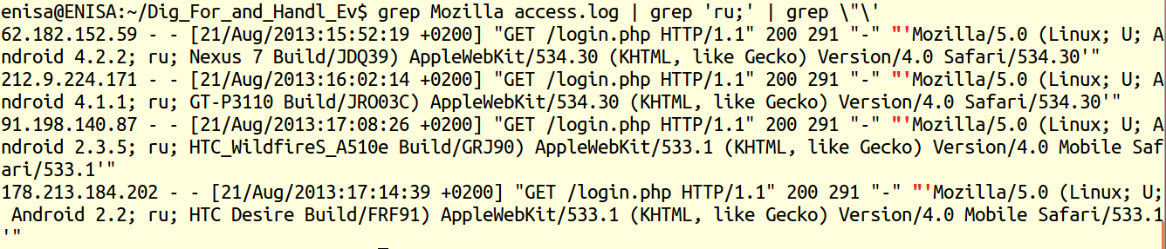

Slide 49
geoiplookup 62.182.152.59
geoiplookup 212.9.224.171
geoiplookup 91.198.140.87
geoiplookup 178.213.184.202
Notes:
Note the last information, connection from Ukraine was redundant – all connections matching the first three conditions matched the fourth and no further selection occurred. We have to match the connections to real users. Again, as we haven’t got cookie information in the access log we must use sources derived from pcap file:

Slide 50
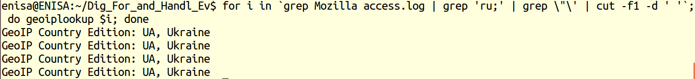

Slide 51
for i in `egrep '62.182.152.59|212.9.224.171|91.198.140.87|178.213.184.202' tshark.log | cut -f 5 -d '|' | cut -f 2 -d '=' `; do grep $i client.csv; done
Notes:
We’ve found four bank customers that had the same connection; of course we’ve found our original customer that complained about the transactions. That’s a very good thing of course. We’ve found three more customers, and the cases should be verified quickly.
Bring to the attention of all trainees that, even if in this example there was a 1:1 match between data sets, we do not need that match in every case to issue an alert. Any money transfer to the same account that follows a fraudulent pattern is suspicious. Every login with a match with a strong connection pattern is suspicious even if there was no transfer of money, it might just have failed for a number of reasons. If all but one suspicious connection were from a single country, VPN or Tor network might have been used.

Slide 52
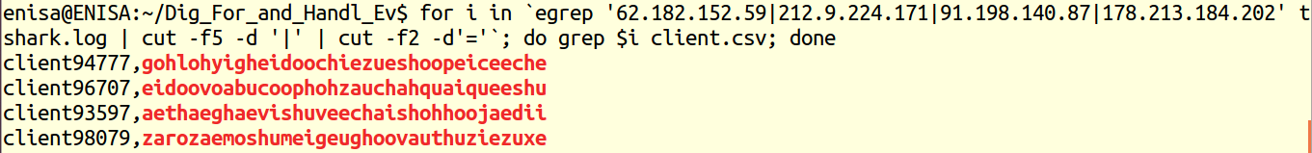

Slide 53
Apparently he has logged in from Ukraine, or somebody who has his credentials. Since we have many similar occasions it is worth looking into.
What have you found out?

Slide 54
Do you still have the contact of a customer who complained, and would he give access to his computer, I would like to make sure it is not infected with some kind of malware.
Yes I could call him and ask? I need to first confirm that he was not in Ukraine.

Slide 55
Hello, this is PL BANK, have you been to Ukraine lately? We have investigated the case, and would it be possible if our technician could verify if your computer is not infected with malware.
Hello this is Peter, Kowalski.
I have not been in Ukraine, OK send your technician in.

Slide 56

Hi, I am from the bank, could I take your laptop for few days.
I just want to make sure that your computer is not infected, or would you allow me to make a copy of a hard drive?
Hello this is Peter, no definitely not, I thought you came just to take a look at my computer.

Slide 57
OK I perfectly understand, would you allow me to get the memory image of your computer, and I will not touch the files on hard drive. If you would allow I would get few minutes of network traffic and file name list from your computer.
No definitely not, I have there data, that cannot be shared or distributed.
Very well, but no files from the hard drive.

Slide 58
Thank you very much, I will let you know shortly what I find. I perfectly understand, that’s why we need to find out what happened.
Thanks, and I remind you I want my money back!

Slide 59
Ok now I have
File system list (fs.list)
Memory dump (memdump.raw)
Network traffic dump (network.pcap)

Slide 60
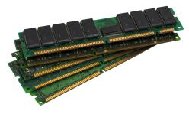
Evaluate gathered evidence
Look for network connections in memory dump
Scan for past connections
Look for processes, including finished ones
Scan API hooks to identify any code injections
Look for keywords: addresses or phrases
Search file list for names found before
Try to find traces with coinciding timestamps
Decide what data to collect, remember about proportionalty

Slide 61
Traffic data
/home/enisa/Dig_For_and_Handl_Ev/network.pcap
Examine raw transmission on the network card
wireshark network.pcap
minimal possible impact on examined computer

Slide 62
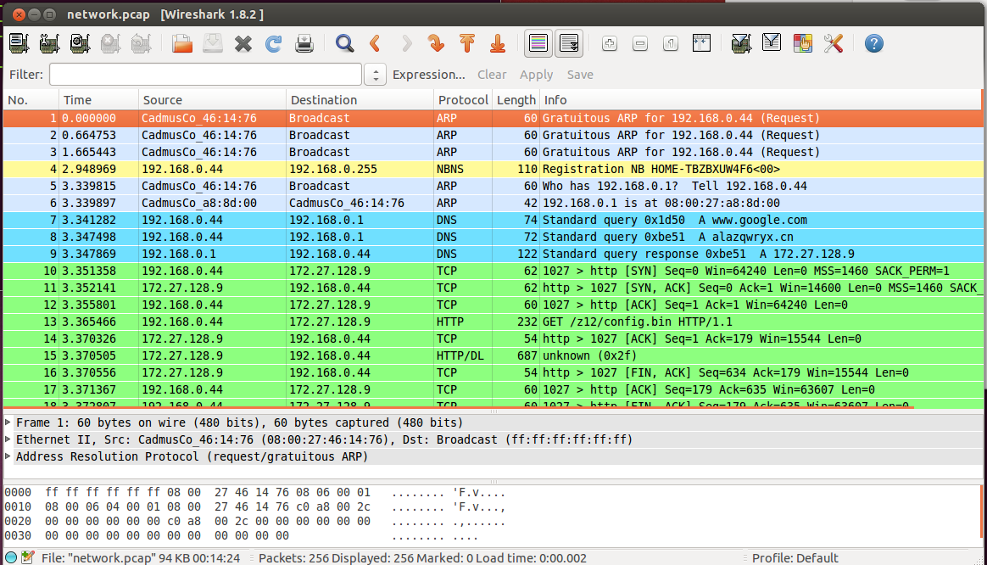

Slide 63

Traffic data
This capture contains data from the moments just after the computer was booted
filter the traffic to DNS only
type ‘dns’ in the ‘Filter’

Slide 64
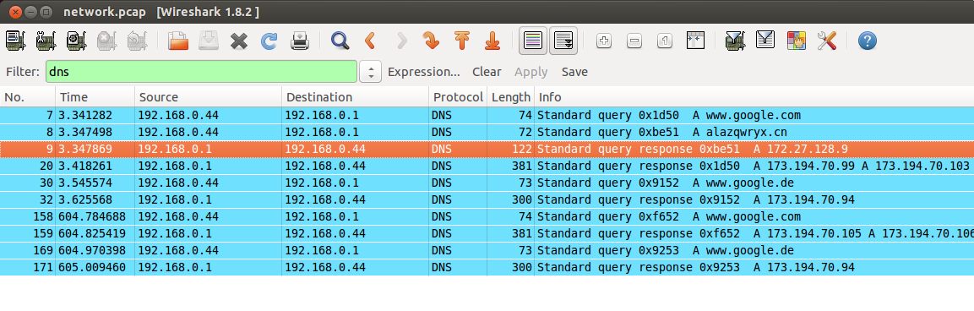
Notes:
tshark -r network.pcap -T fields -e ip.src -e http.request.full_uri | grep http
tshark -r network.pcap -T fields -e ip.src -e dns.qry.name -R "dns.flags.response eq 0“
tshark -r network.pcap -T fields -e ip.src -e ip.dst -e dns.qry.name -e dns.resp.addr | sort -u

Slide 65
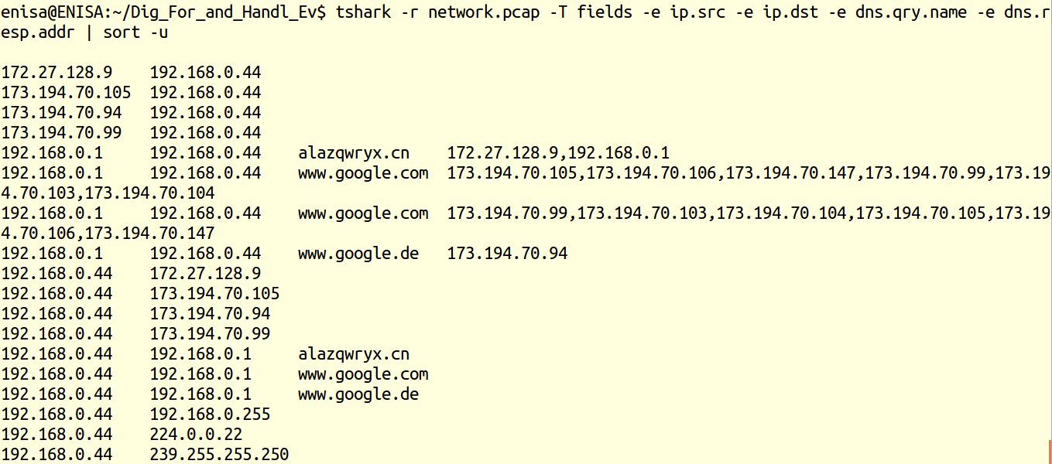
tshark

Slide 66
Traffic data
Google servers
alazqwryx.cn
IP address ‘172.27.128.9’
most probably botnet C&C servers
modify the filter to see what the communications looked like

Slide 67
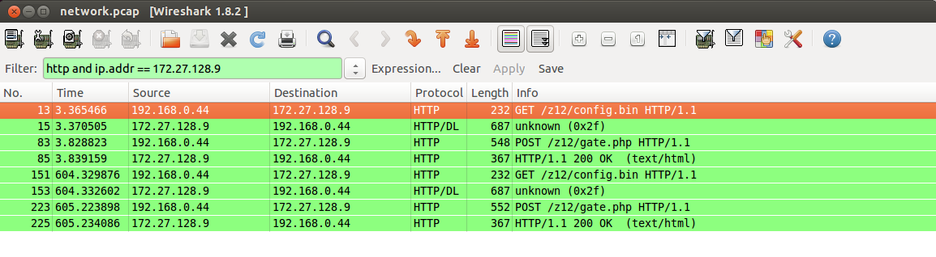
Notes:
tshark -r network.pcap -T fields -e ip.src -e http.request.full_uri | grep http

Slide 68
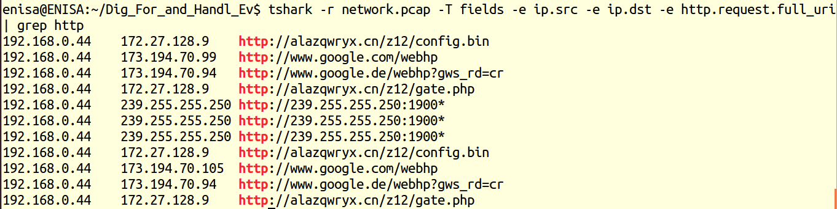
Tshark http

Slide 69
Traffic data
We notice two HTTP requests:
GET /z12/config.bin
POST /z12/gate.php
pattern repeated after roughly 600 seconds
HTTP requests format suggests this is some ZeuS variant

Slide 70
https://code.google.com/p/volatility/

Slide 71
Intro to Volatility
The Volatility Framework:
Completely open collection of tools, implemented in Python under the GNU General Public License, for the extraction of digital artifacts from volatile memory (RAM) samples.
The extraction techniques are performed completely independent of the system being investigated but offer unprecedented visibility into the runtime state of the system.
The framework is intended to introduce people to the techniques and complexities associated with extracting digital artifacts from volatile memory samples and provide a platform for further work into this exciting area of research.

Slide 72
Using volatility I
$ python vol.py -f [image] --profile=[profile] [plugin]
$ python vol.py -f /path/to/memory.img --profile=Win7SP1x64 pslist
$ python vol.py -f ~/Desktop/win7_trial_64bit.raw imageinfo Volatile Systems Volatility Framework 2.1_alpha Determining profile based on KDBG search... Suggested Profile(s) : Win7SP0x64, Win7SP1x64, Win2008R2SP0x64, Win2008R2SP1x64 AS Layer1 : AMD64PagedMemory (Kernel AS) AS Layer2 : FileAddressSpace (/Users/Michael/Desktop/win7_trial_64bit.raw) PAE type : PAE DTB : 0x187000L KDBG : 0xf80002803070 Number of Processors : 1 Image Type (Service Pack) : 0 KPCR for CPU 0 : 0xfffff80002804d00L KUSER_SHARED_DATA : 0xfffff78000000000L Image date and time : 2012-02-22 11:29:02 UTC+0000 Image local date and time : 2012-02-22 03:29:02 -0800

Slide 73
TOols
Belkasoft Live RAM Capture
WindowsSCOPE Live
winen.exe
Mdd (Memory DD) (ManTech)
MANDIANT Memoryze
Moonsols DumpIt
http://www.forensicswiki.org/wiki/Memory_analysis

Slide 74
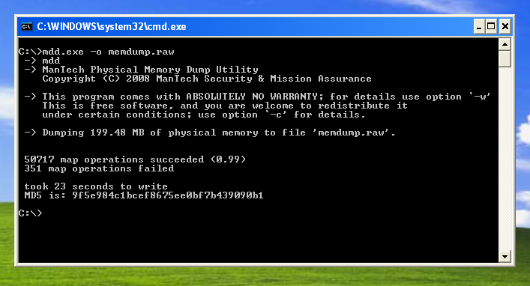
Dump of physical memory
Notes:
mdd, also known as ManTech dd or Memory dd, is a command line program to acquire an image of the memory of a running Windows computer. The program has been included in the Helix incident response tool.
The current version of mdd (mdd_1.3.exe) runs on Window XP to SP3 and Vista to SP 2, and may run on other versions.
The driver uses the Physical Memory Object Memory Imaging Mehod and returns a file handle to a user-mode program via an IOCTL on the device file named:

Slide 75
Dump of physical memory
/home/enisa/enisa/forensic2/memdump.raw
Standard command lines utils (bash, grep, sort, cut, etc.)
Volatility Framework ver. 2.3
Notes:
The Volatility Framework is a completely open collection of tools, implemented in Python under the GNU General Public License, for the extraction of digital artifacts from volatile memory (RAM) samples. The extraction techniques are performed completely independent of the system being investigated but offer unprecedented visibilty into the runtime state of the system. The framework is intended to introduce people to the techniques and complexities associated with extracting digital artifacts from volatile memory samples and provide a platform for further work into this exciting area of research.
Capabilities
The Volatility Framework currently provides the following extraction capabilities for memory samples
Image information (date, time, CPU count)
Running processes
Process SIDs and environment variables
Open network sockets
Open network connections
DLLs loaded for each process
Open handles to all kernel/executive objects (files, keys, mutexes)
OS kernel modules
Dump any process, DLL, or module to disk
Mapping physical offsets to virtual addresses
Virtual Address Descriptor information
Addressable memory for each process
Memory maps for each process
Extract executable samples
Scanning examples: processes, threads, sockets, connections, modules
Command histories (cmd.exe) and console input/output buffers
Imported and exported API functions
PE version information
System call tables (IDT, GDT, SSDT)
API hooks in user- and kernel-mode (inline, IAT, EAT, NT syscall, winsock)
Explore cached registry hives
Dump LM/NTLM hashes and LSA secrets
User assist and shimcache exploration
Scan for byte patterns, regular expressions, or strings in memory
Analyze kernel timers and callback functions
Report on windows services

Slide 76
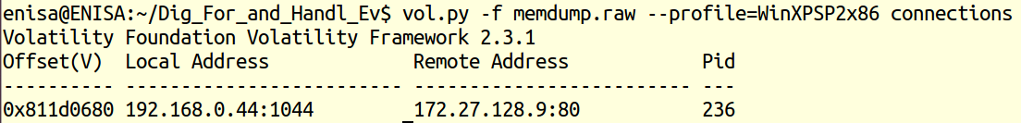
Connections
x86 and x64 Windows XP and Windows 2003 Server
Notes:
http://code.google.com/p/volatility/wiki/CommandReference23#connections
Tcpip.sys
To view TCP connections that were active at the time of the memory acquisition, use the connections command. This walks the singly-linked list of connection structures pointed to by a non-exported symbol in the tcpip.sys module.
This command is for x86 and x64 Windows XP and Windows 2003 Server only.

Slide 77
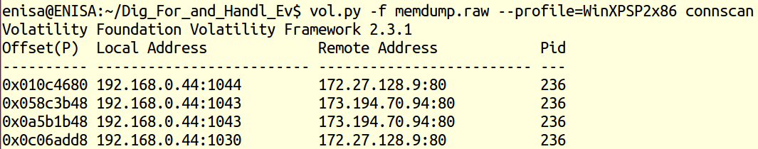
Connscan (past connections, but still not overwritten by other data)
x86 and x64 Windows XP and Windows 2003 Server
Notes:
To find _TCPT_OBJECT structures using pool tag scanning, use the connscan command. This can find artifacts from previous connections that have since been terminated, in addition to the active ones.
We’ve discussed several areas of Memory Management in our blog since we started. Today, we’re going to take a look at Pool Tags and how they can be used to identify the source of Pool Memory leaks. A pool tag is a four-byte character that is associated with a dynamically allocated chunk of pool memory. The tag is specified by a driver when it allocates the memory. The routine ExAllocatePoolWithTag is called to allocate pool memory. There are three parameters that are specified when this routine is called:
PoolType: This specifies the type of pool memory to allocate – Paged or NonPaged pool.
NumberofBytes: This is self-explanatory and specifies the number of bytes to allocate for the memory request
Tag: This specifies the pool tag. The tag is a four-byte character as we mentioned above, and is stored (and sometimes displayed) in reverse order – known as little-endian. So if our driver made a request to allocate memory with the tag “Fred”, it appears as “derF” in a pool dump. The ASCII value of each character in the tag must be between 0 and 127 – so in our example, the ASCII value as seen in the registry would be 0x64657246.

Slide 78
Connections and PID
IP 173.194.70.94 port 80
we identified the windows process ID (PID) that opened the connections: 236

Slide 79
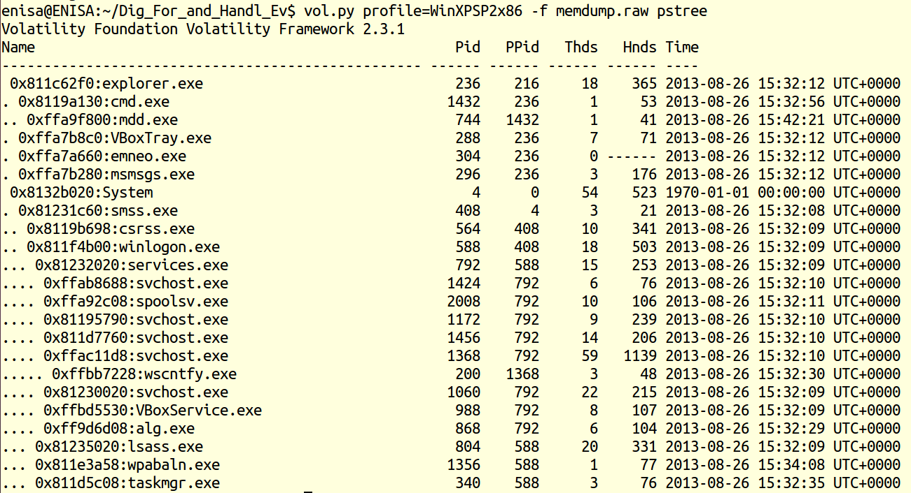
pslist and pstree
Notes:
To view the process listing in tree form, use the pstree command. This enumerates processes using the same technique as pslist, so it will also not show hidden or unlinked processes. Child process are indicated using indention and periods.

Slide 80
Psxview
This plugin helps you detect hidden processes by comparing what is reported by various other sources of process listings
Notes:
PsActiveProcessHead linked list
EPROCESS pool scanning
ETHREAD pool scanning (then it references the owning EPROCESS)
PspCidTable
Csrss.exe handle table
Csrss.exe internal linked list

Slide 81
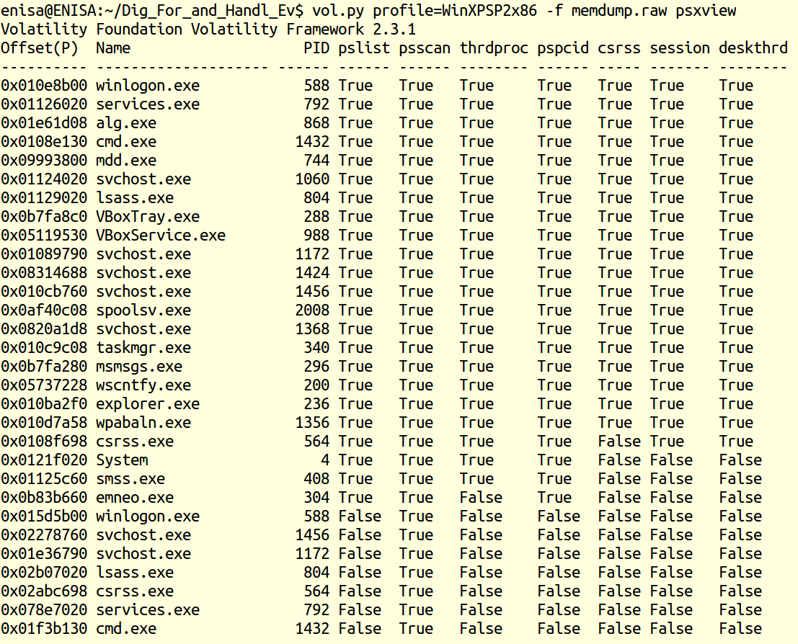

Slide 82
Processes
Process number 236 is explorer.exe
Main process of the Windows user interface
Something might had injected malicious code into one of explorer’s threads
Process ‘emneo.exe’ which started and quit almost immediately

Slide 83
Malfind
Helps to find hidden or injected code/DLLs in user mode memory
The purpose of malfind is to locate DLLs that standard methods/tools do not see
Otherwise use Dlllist command
Can send output to file
Notes:
malfind
The malfind command helps find hidden or injected code/DLLs in user mode memory, based on characteristics such as VAD tag and page permissions.
Note: malfind does not detect DLLs injected into a process using CreateRemoteThread->LoadLibrary. DLLs injected with this technique are not hidden and thus you can view them with dlllist. The purpose of malfind is to locate DLLs that standard methods/tools do not see. For more information see Issue #178 .
Here is an example of using it to detect the presence of Zeus. The first memory segment (starting at 0x01600000) was detected because its executable, marked as private (not shared between processes) and has a VadS tag...which means there is no memory mapped file already occupying the space. Based on a disassembly of the data found at this address, it seems to contain some API hook trampoline stubs.
The second memory segment (starting at 0x015D0000) was detected because it contained an executable that isn't listed in the PEB's module lists.
If you want to save extracted copies of the memory segments identified by malfind, just supply an output directory with -D or --dump-dir=DIR. In this case, an unpacked copy of the Zeus binary that was injected into explorer.exe would be written to disk.

Slide 84
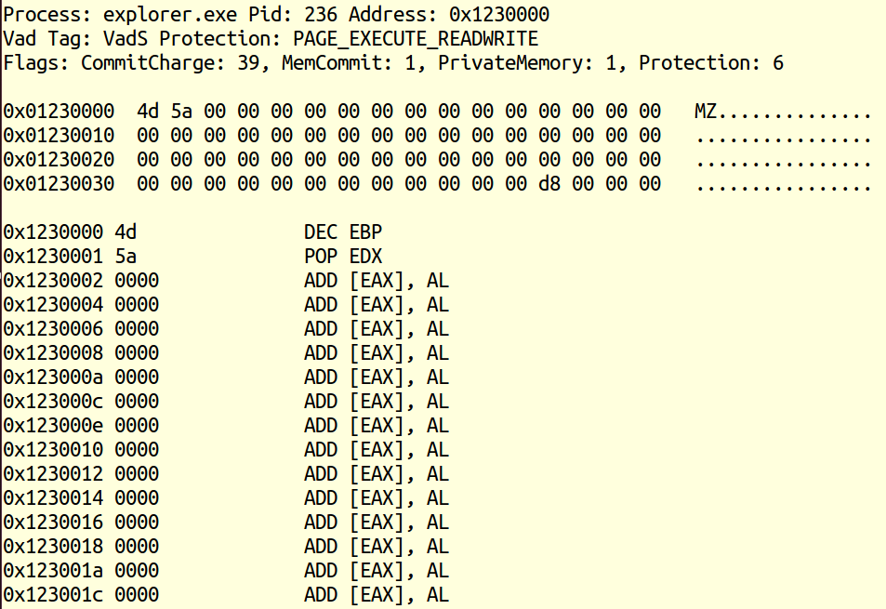

Slide 85
Handles
Displays the open handles in a process
Applies to files, registry keys, mutexes, named pipes, events, window stations, desktops, threads, etc.

Slide 86
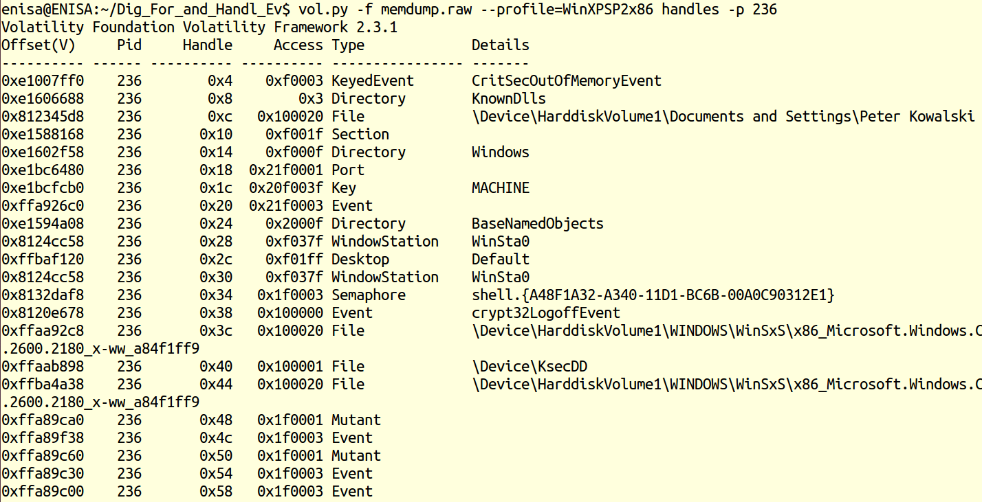

Slide 87
Dlllist
Displays a process's loaded DLLs
Notes:
To display a process's loaded DLLs, use the dlllist command. It walks the doubly-linked list of LDR_DATA_TABLE_ENTRY structures which is pointed to by the PEB's InLoadOrderModuleList. DLLs are automatically added to this list when a process calls LoadLibrary (or some derivative such as LdrLoadDll) and they aren't removed until FreeLibrary is called and the reference count reaches zero. The load count column tells you if a DLL was statically loaded (i.e. as a result of being in the exe or another DLL's import table) or dynamically loaded.
To display the DLLs for a specific process instead of all processes, use the -p or --pid filter as shown below. Also, in the following output, notice we're analyzing a Wow64 process. Wow64 processes have a limited list of DLLs in the PEB lists, but that doesn't mean they're the only DLLs loaded in the process address space. Thus Volatility will remind you to use the ldrmodules instead for these processes.
To display the DLLs for a process that is hidden or unlinked by a rootkit, first use the psscan to get the physical offset of the EPROCESS object and supply it with --offset=OFFSET. The plugin will "bounce back" and determine the virtual address of the EPROCESS and then acquire an address space in order to access the PEB.

Slide 88
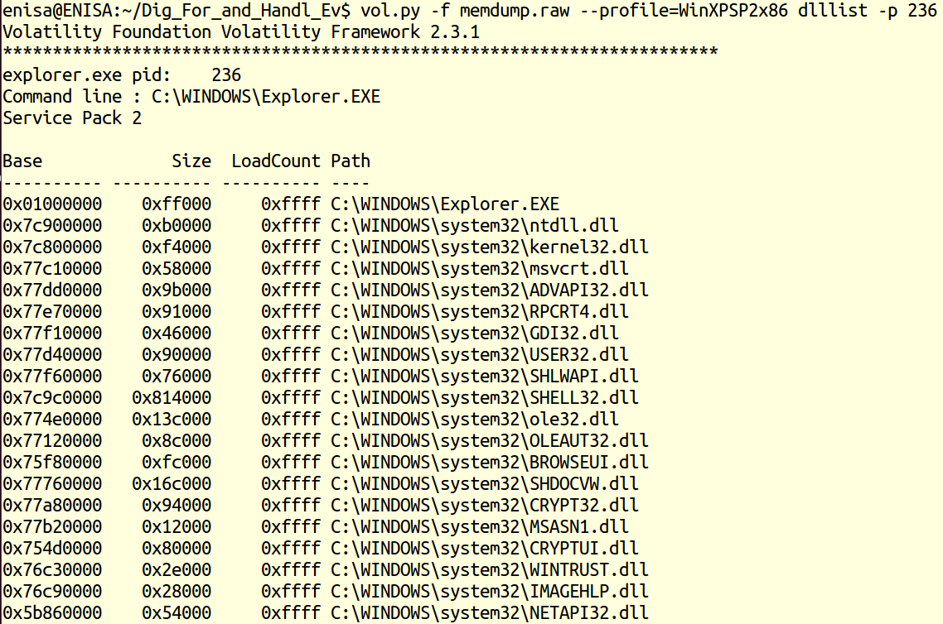
Notes:
To extract a DLL from a process's memory space and dump it to disk for analysis, use the dlldump command. The syntax is nearly the same as what we've shown for dlllist above. You can:
Dump all DLLs from all processes
Dump all DLLs from a specific process (with --pid=PID)
Dump all DLLs from a hidden/unlinked process (with --offset=OFFSET)
Dump a PE from anywhere in process memory (with --base=BASEADDR), this option is useful for extracting hidden DLLs
Dump one or more DLLs that match a regular expression (--regex=REGEX), case sensitive or not (--ignore-case)
To specify an output directory, use --dump-dir=DIR or -d DIR.

Slide 89
Hivelist
To locate the virtual addresses of registry hives in memory, and the full paths to the corresponding hive on disk.
Notes:
To locate the virtual addresses of registry hives in memory, and the full paths to the corresponding hive on disk, use the hivelist command. If you want to print values from a certain hive, run this command first so you can see the address of the hives.

Slide 90
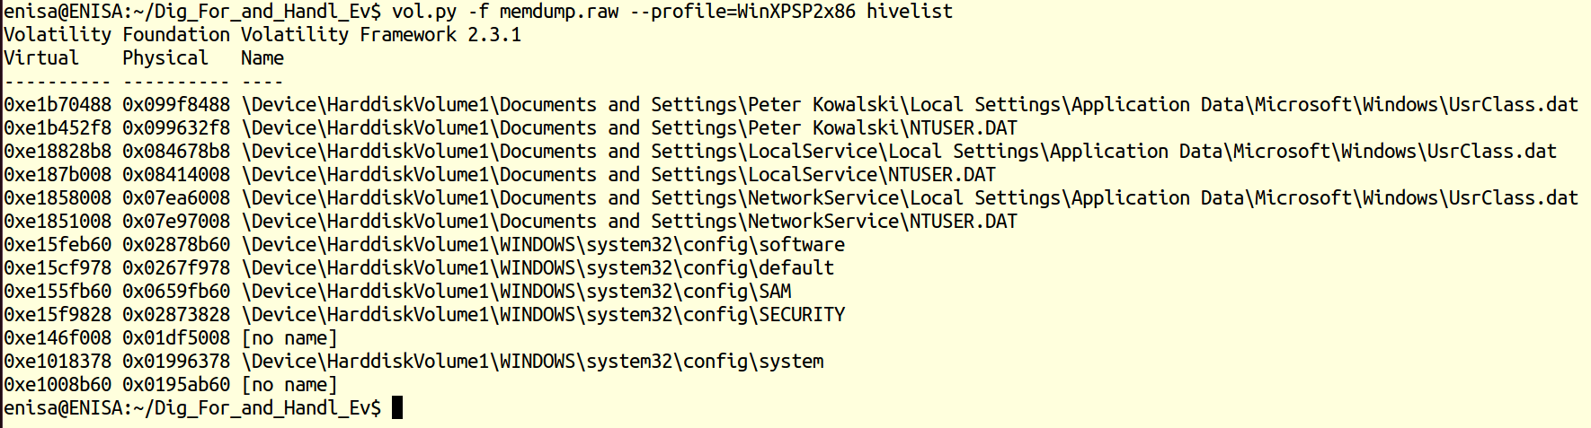
Hivelist

Slide 91
Printkey
To display the subkeys, values, data, and data types contained within a specified registry key.
Notes:
To display the subkeys, values, data, and data types contained within a specified registry key, use the printkey command. By default, printkey will search all hives and print the key information (if found) for the requested key. Therefore, if the key is located in more than one hive, the information for the key will be printed for each hive that contains it.
Say you want to traverse into the HKEY_LOCAL_MACHINE\Microsoft\Security Center\Svc key. You can do that in the following manner. Note: if you're running Volatility on Windows, enclose the key in double quotes
Here you can see how the output appears when multiple hives (DEFAULT and ntuser.dat) contain the same key "Software\Microsoft\Windows NT\CurrentVersion".

Slide 92
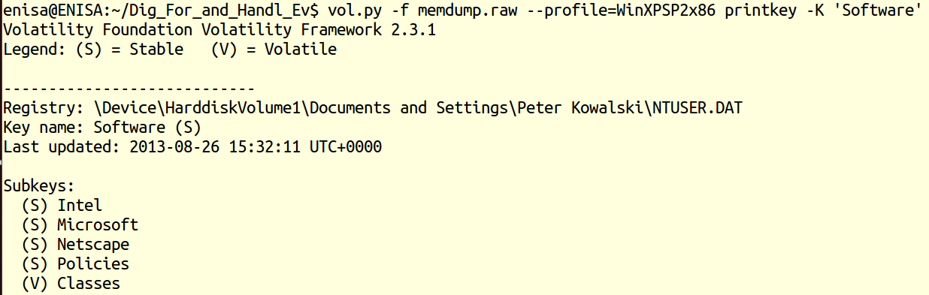
Printkey

Slide 93
Apihooks
Find API hooks in user mode or kernel mode, use the apihooks plugin.
Notes:
To find API hooks in user mode or kernel mode, use the apihooks plugin. This finds IAT, EAT, Inline style hooks, and several special types of hooks. For Inline hooks, it detects CALLs and JMPs to direct and indirect locations, and it detects PUSH/RET instruction sequences. It also detects CALLs or JMPs to registers after an immediate value (address) is moved into the register. The special types of hooks that it detects include syscall hooking in ntdll.dll and calls to unknown code pages in kernel memory.
As of Volatility 2.1, apihooks also detects hooked winsock procedure tables, includes an easier to read output format, supports multiple hop disassembly, and can optionally scan quicker through memory by ignoring non-critical processes and DLLs.
Here is an example of detecting IAT hooks installed by Coreflood. The hooking module is unknown because there is no module (DLL) associated with the memory in which the rootkit code exists. If you want to extract the code containing the hooks, you have a few options:
1. See if malfind can automatically find and extract it.
2. Use volshell dd/db commands to scan backwards and look for an MZ header. Then pass that address to dlldump as the --base value.
3. Use vaddump to extract all code segments to individual files (named according to start and end address), then find the file that contains the 0x7ff82 ranges.

Slide 94
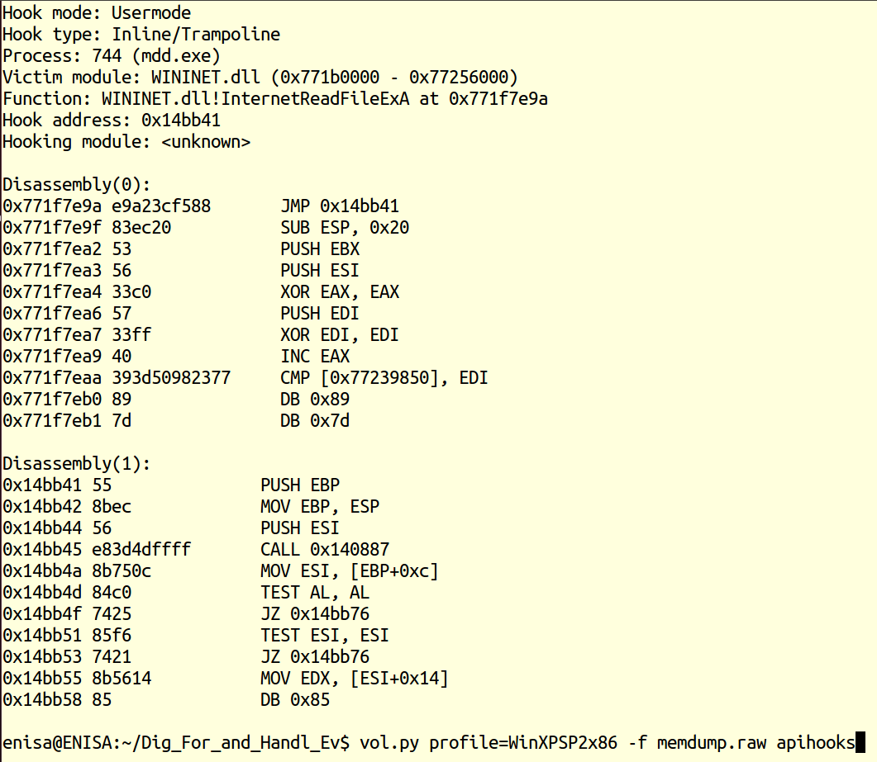
‘API hooks’
and wait 5-50 min

Slide 95
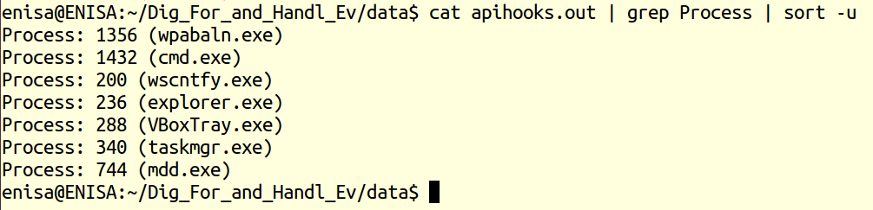
what processes memory spaces contained hooks with something registered
Notes:
In computer programming, the term hooking covers a range of techniques used to alter or augment the behavior of an operating system, of applications, or of other software components by intercepting function calls or messages or events passed between software components. Code that handles such intercepted function calls, events or messages is called a "hook".
Hooking is used for many purposes, including debugging and extending functionality. Examples might include intercepting keyboard or mouse event messages before they reach an application, or intercepting operating system calls in order to monitor behavior or modify the function of an application or other component.
Hooking can also be used by malicious code. For example, rootkits, pieces of software that try to make themselves invisible by faking the output of API calls that would otherwise reveal their existence, often use hooking techniques. A wallhack is another example of malicious behavior that can stem from hooking techniques. It is done by intercepting function calls in a computer game and altering what is shown to the player to allow them to gain an unfair advantage over other players.

Slide 96
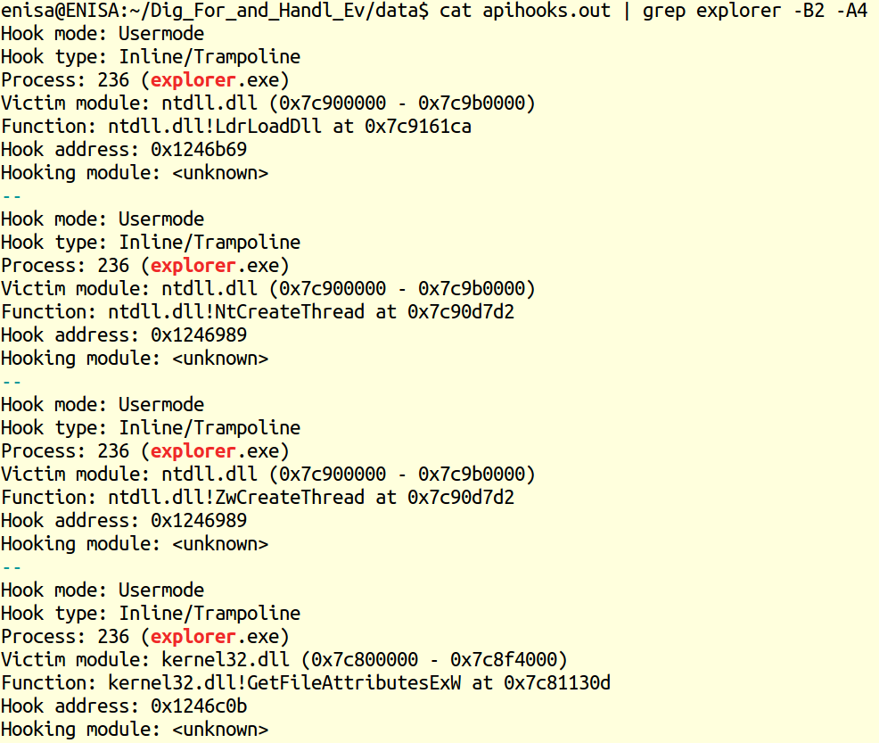

Slide 97
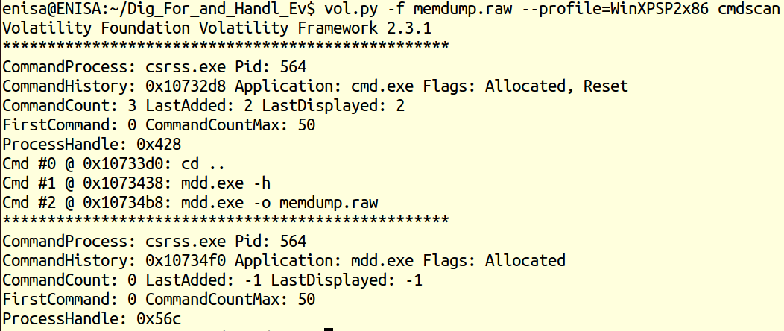
Cmdscan
Notes:
To find API hooks in user mode or kernel mode, use the apihooks plugin. This finds IAT, EAT, Inline style hooks, and several special types of hooks. For Inline hooks, it detects CALLs and JMPs to direct and indirect locations, and it detects PUSH/RET instruction sequences.

Slide 98
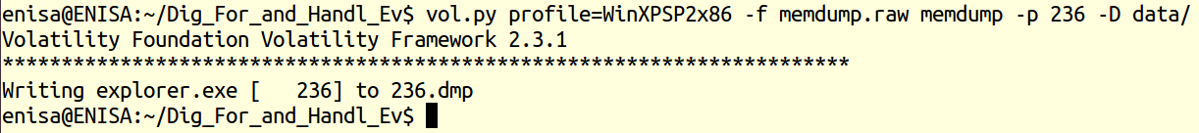
Memdump and explorer.exe
Extract from the computer memory image the memory space of explorer.exe
Notes:
To extract all memory resident pages in a process (see memmap for details) into an individual file, use the memdump command. Supply the output directory with -D or --dump-dir=DIR.

Slide 99
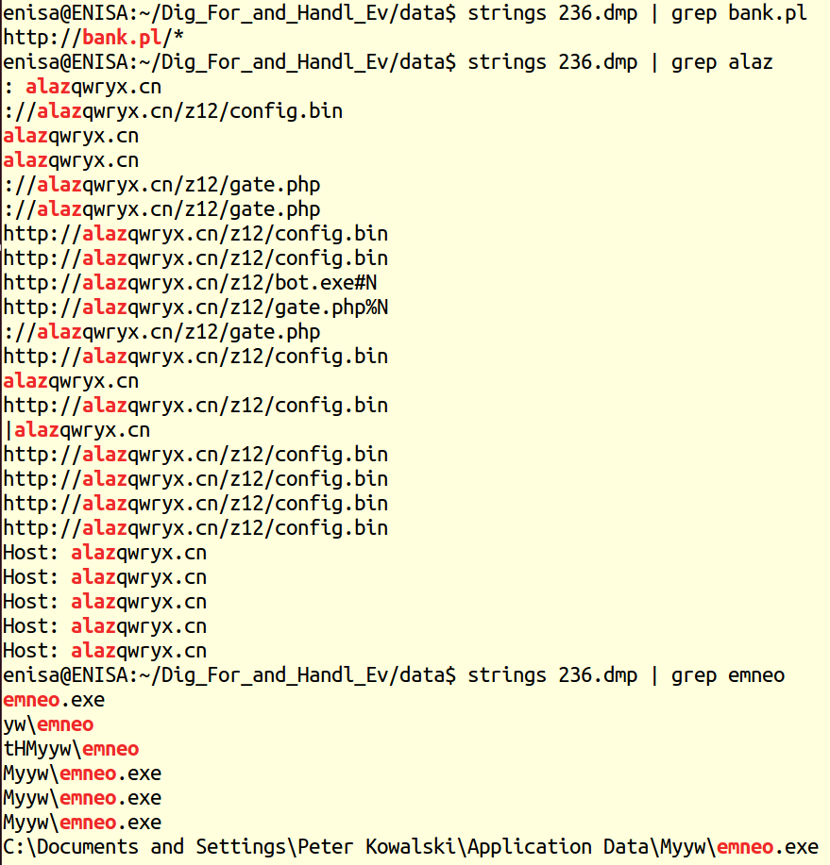
strings

Slide 100
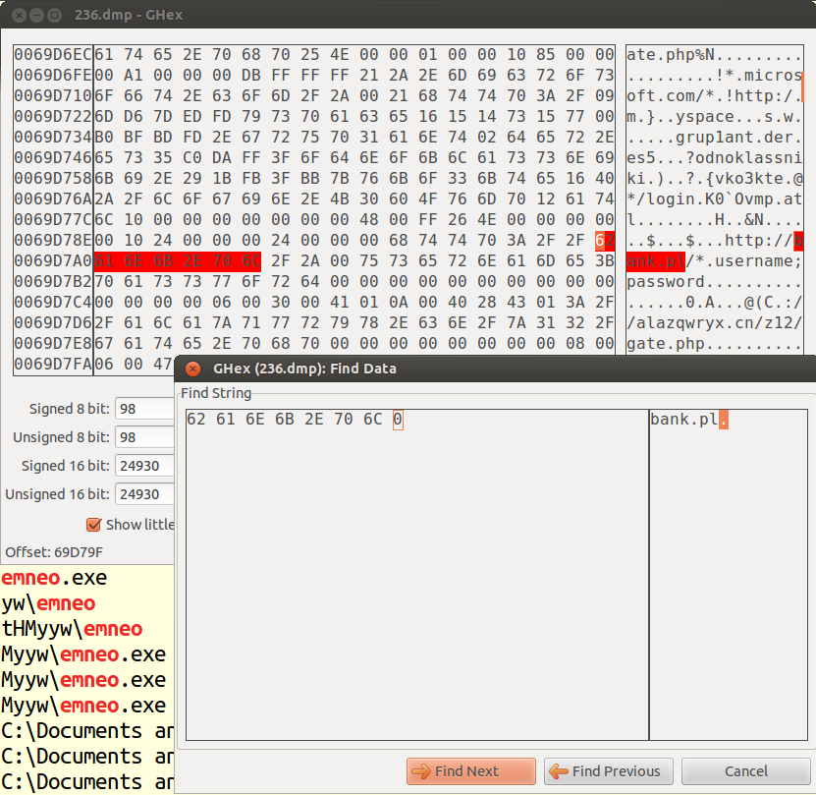
hex editor

Slide 101
Find files related to the malware found

Slide 102
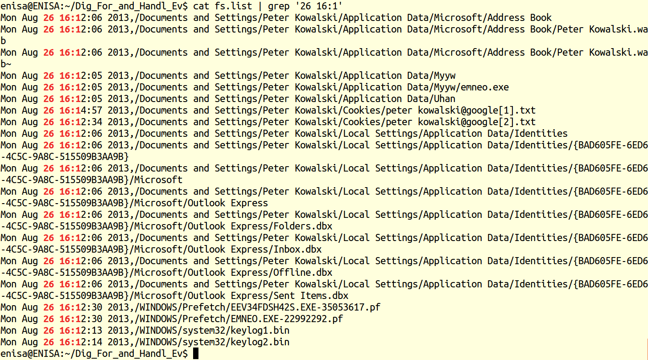

Slide 103
Next phase
Command lines utils (bash, grep, sort, cut, etc.)
Volatility Framework ver. 2.0 with zeusscan plugins
Script decrypting malware config file

Slide 104
vol20.py profile=WinXPSP2x86 –f memdump.raw zeusscan1
vol20.py profile=WinXPSP2x86 –f memdump.raw zeusscan2

Slide 105
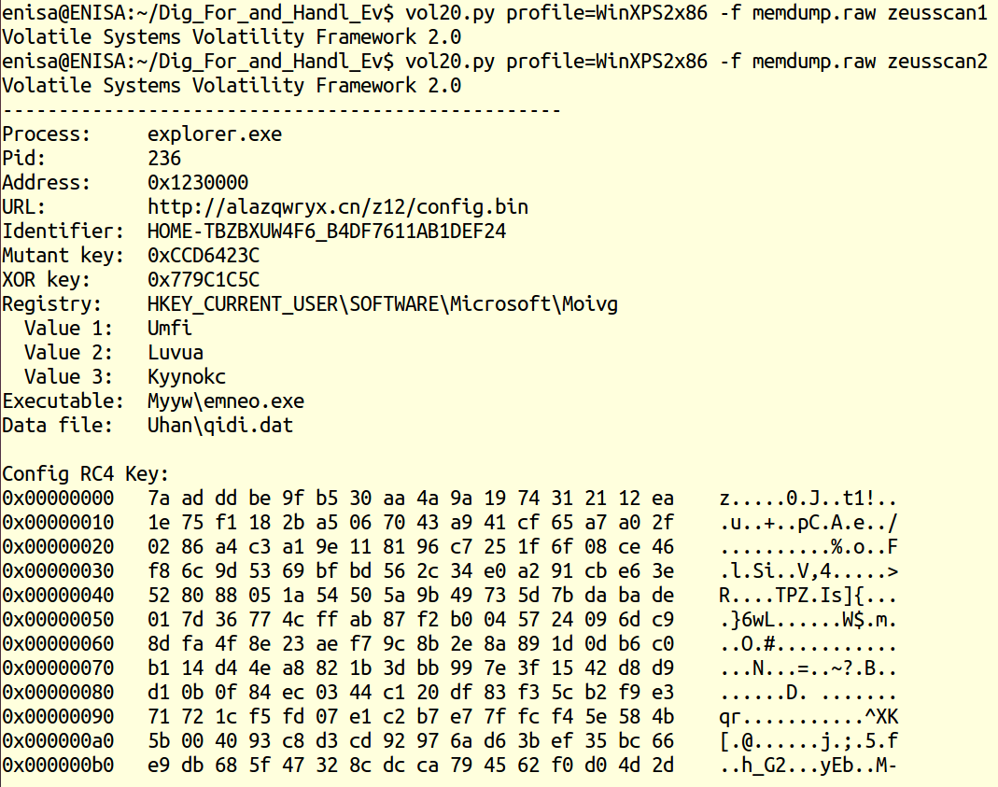

Slide 106
What we found out
ZeuS version 2.x
For each infected process the zeusscan scripts returns an RC4 script used for decrypting the ZeuS config file, along with some more information: binary file path, datafile path, windows registry keys and the config file location

Slide 107
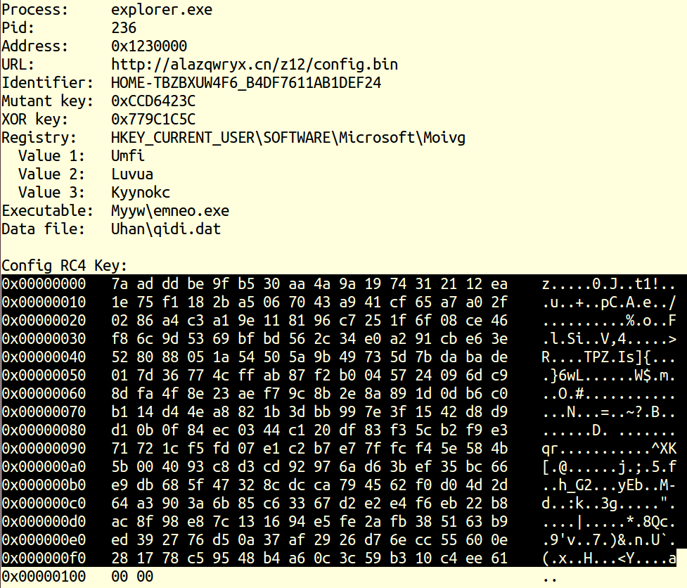

Slide 108
We need to access the config file data so we need to decrypt it first. We copy the config file and save it in data/key.txt file:

Slide 109
We may achieve it with a text editor of choice or use basic Unix console mechanisms:
cd data
cat > key.txt
now paste the data (middle mouse button can be used) and press Ctrl-D at the end.
verify the contents of the file:

Slide 110
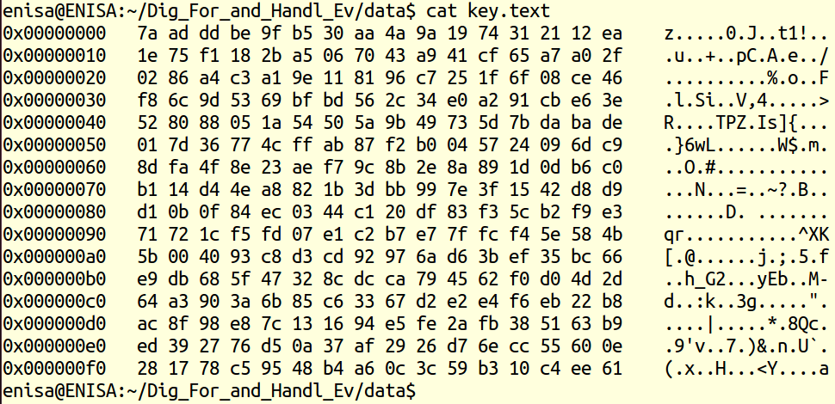

Slide 111
All data was copied correctly, but the file has a ‘hexdump’ format, which is unsuitable for processing. We need to convert it to a binary format, which can be achieved with a simple one-line script:
cat key.txt | cut -d ' ' -f 4-19 | xxd -r -p > key.bin
This script first extracts the middle column (the one with a list of character pairs) and then converts the pairs (hexadecimal values) to corresponding byte values.
Notes:
http://linuxcommand.org/man_pages/xxd1.html

Slide 112
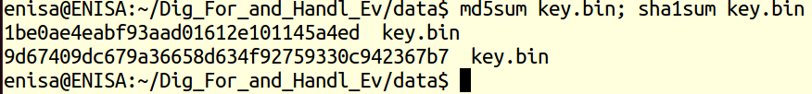

Slide 113
At this time we’ve got an RC4 key which we use to decrypt the config file. All we need is a config file.

Slide 114
We open the network.pcap file in Wireshark and enter the ‘http’ filter in the Filter field (and click Apply button):
there was an http request for /z12/config.bin in frame 13. Frame 15 contains server’s reply.
We select the frame and press Ctrl-H or use File->Export Selected Packet Bytes from the Wireshark menu:

Slide 115
Go to No. 15
Select Media type, application /octet-stream
Export selected packets (config.bin)

Slide 116
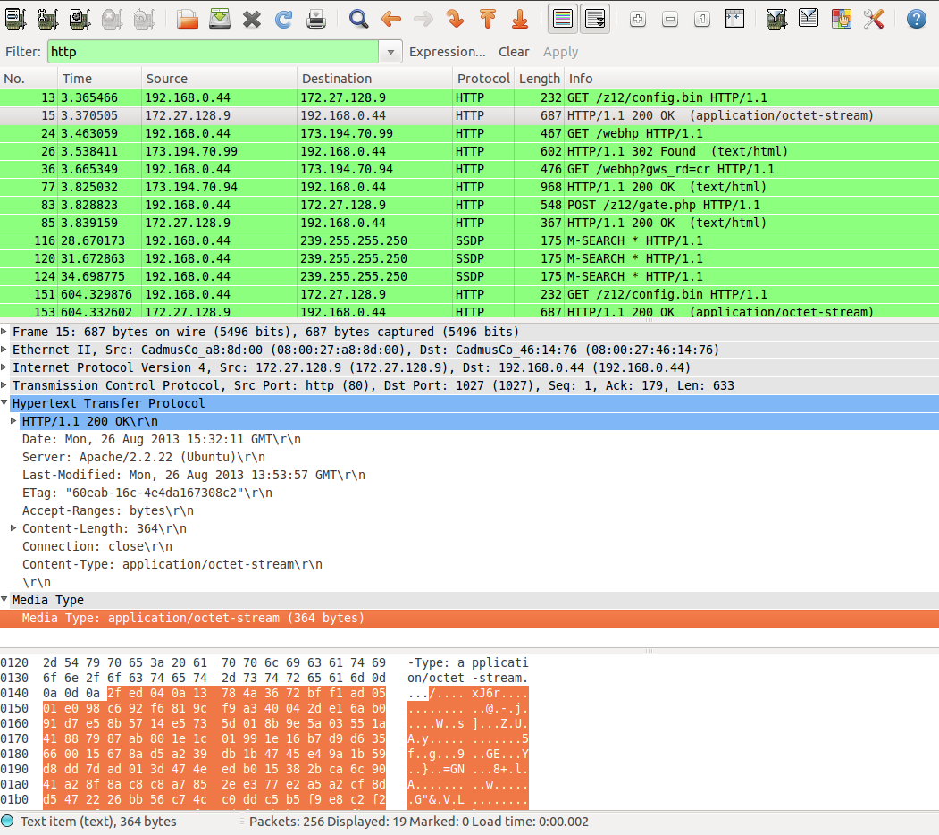

Slide 117
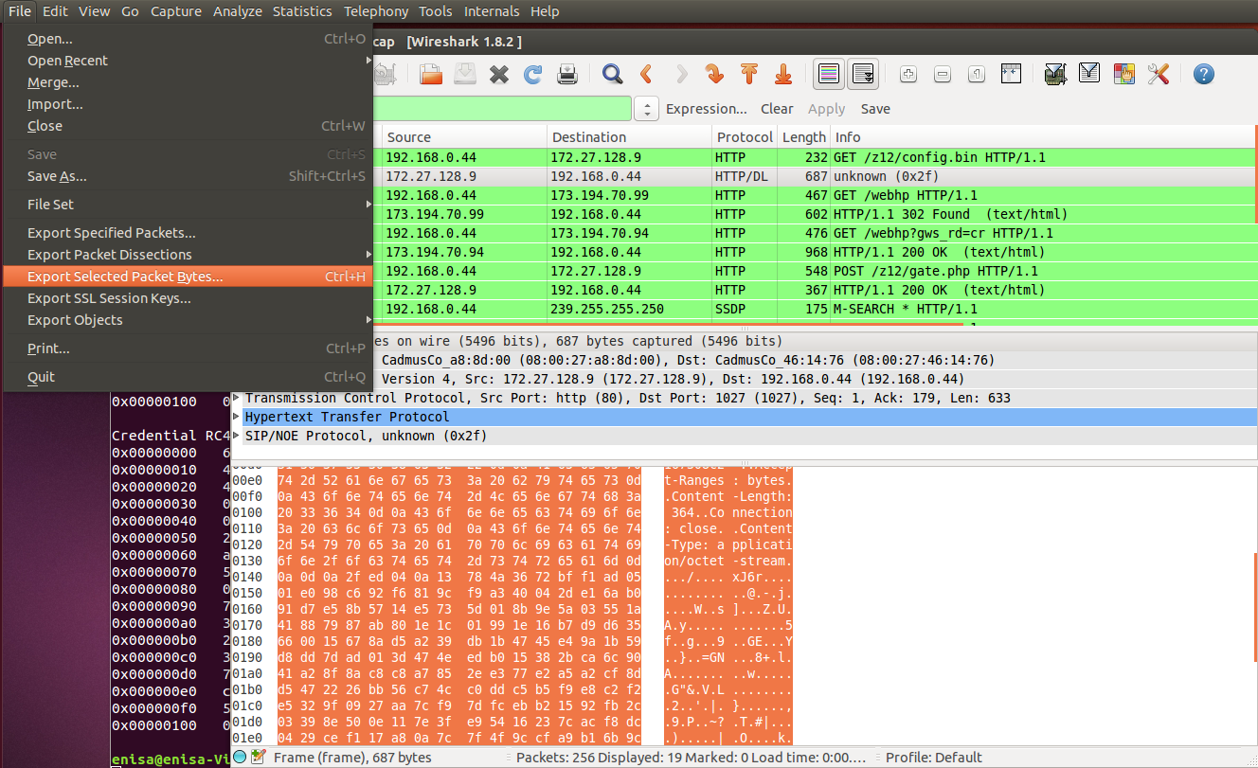

Slide 118
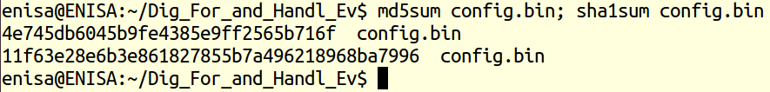

Slide 119
Now we can look into the config file. We remember it’s encrypted with an RC4 file, in this case the file in key.bin file. There is a script for that case, based on leaked ZeuS source code and documentation, zdecrypt.py:
Notes:
http://mnin.blogspot.gr/2011/09/abstract-memory-analysis-zeus.html#!/2011/09/abstract-memory-analysis-zeus.html

Slide 120
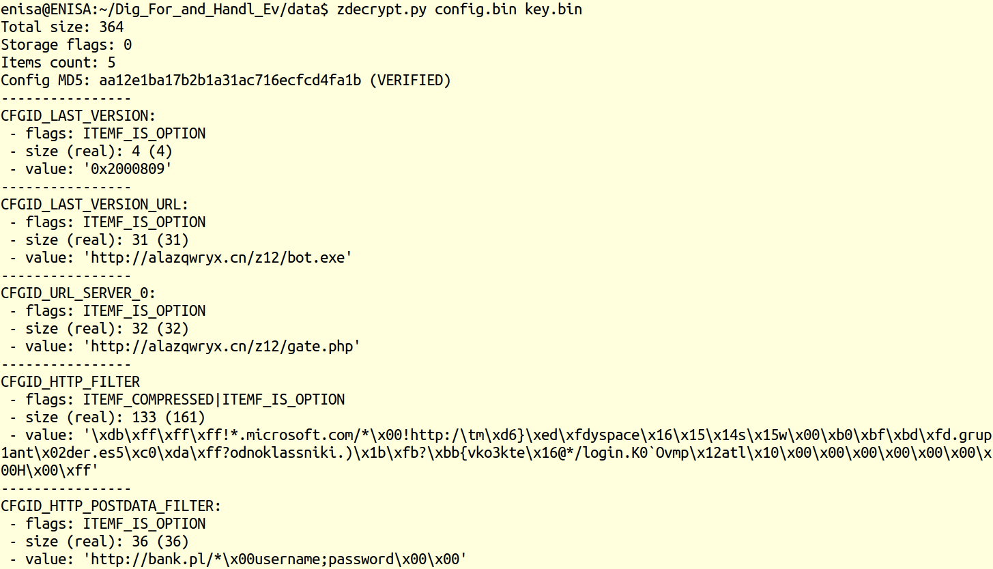

Slide 121
First section, CFGID_LAST_VERSION there’s the information about the bot version. In this case the value reads 0x02000809, which we interpret as 2.0.8.9 version.
In the two sections following we can see the URL addresses to the bot binary file (bot.exe) and the reporting location (gate.php). The former address is used by malware to report to the C&C and send any data stolen from infected systems.

Slide 122
2 memory samples
20140605
20140423
Unzip them and provide as detailed analysis as possible
Potentially malicious processes
Network communication
Reg keys
Etc.

Slide 123
Discussion
Chain of Custody
Would you be able to discredit the evidence?
Would you be able to discredit the way it was collected?
Would you be able to discredit the expert who collected it?
Remember, the experts on the opposite side will try to …

Slide 124
`
Thank you for your attention!

